Slide 1
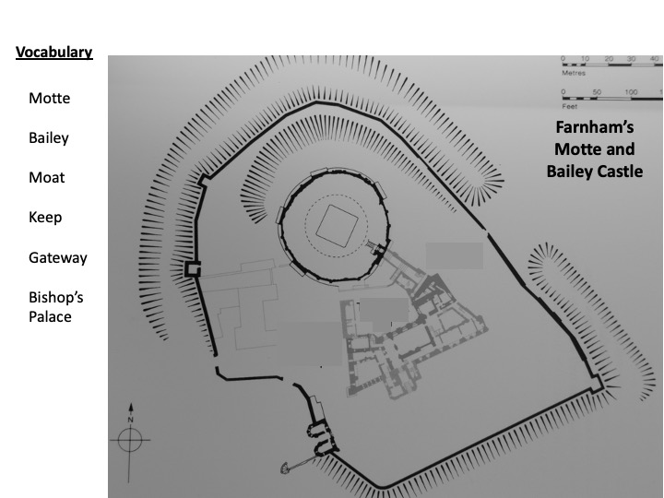

Slide 8
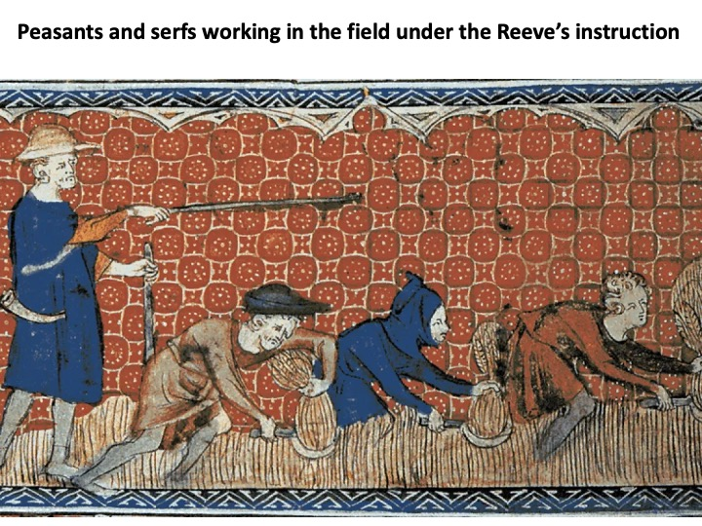

Slide 11
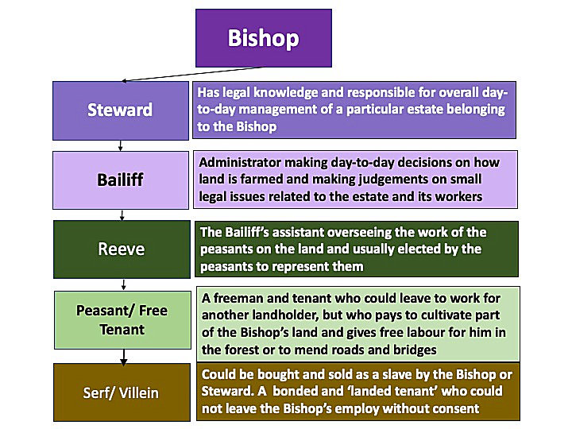

Slide 12
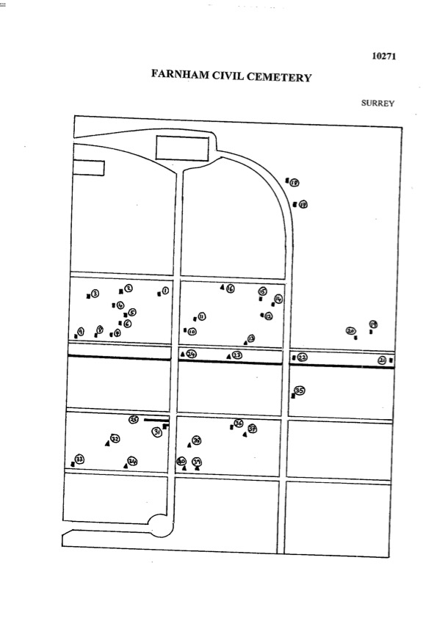
Farnham’ West Street Cemetery
Farnham Town & Museum
West Street
Albert’s Grave
Wall
Mike Hawthorn’s Grave Grave
Car Park
Coxbridge Roundabout and A31

Slide 13
